Slide 1
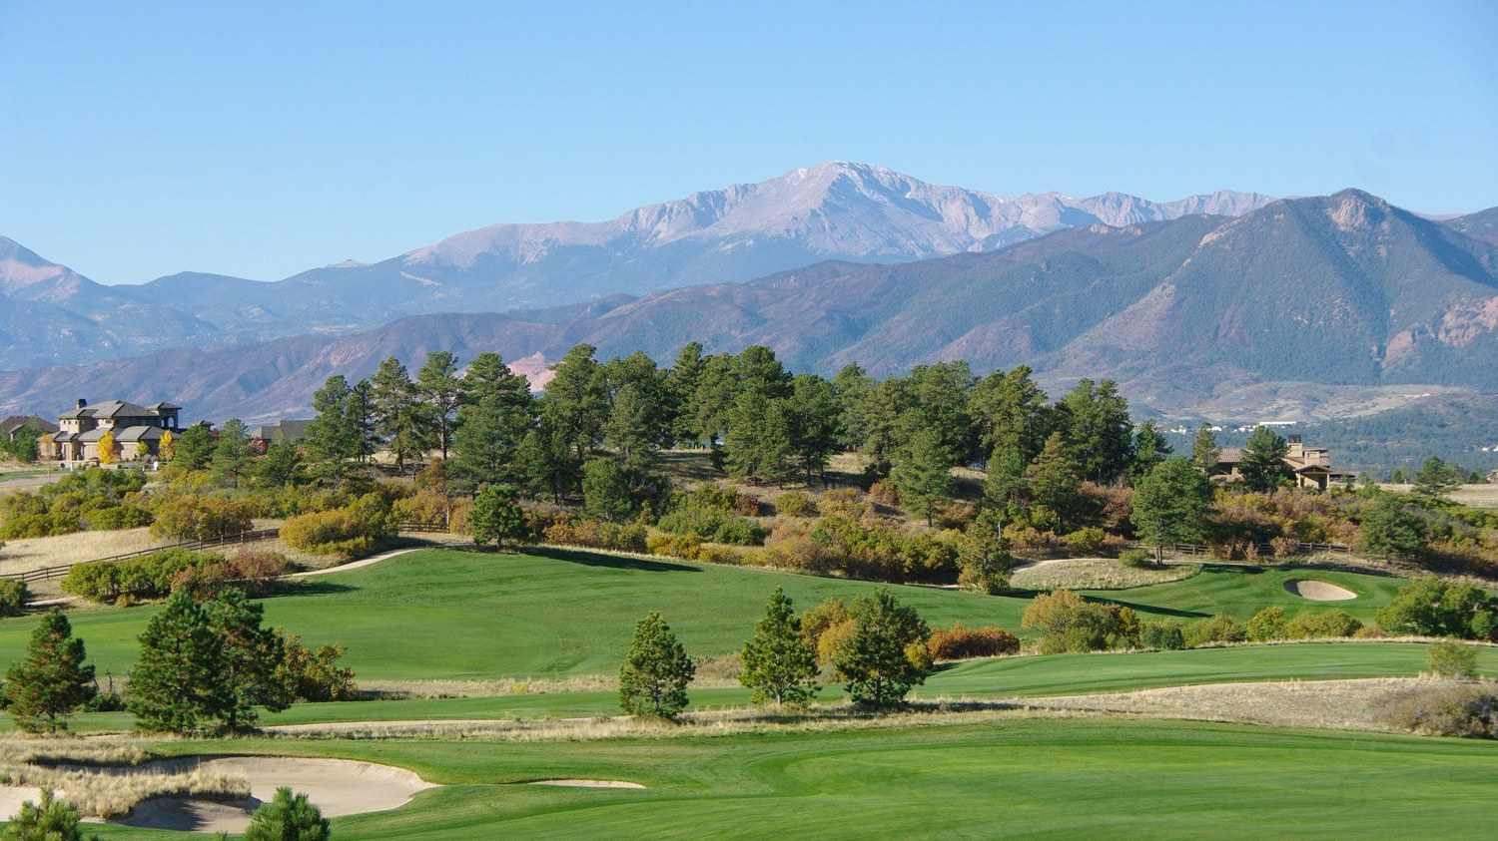

A PROPOSAL FOR INNOSPEC FUEL SPECIALTIES
A Weekend Worthy of Our Heroes
2027 Charity Golf Tournament benefiting the PenFed Foundation Military Heroes Program
SUNDAY, AUGUST 15 + MONDAY, AUGUST 16, 2027 | COLORADO SPRINGS, COLORADO
Notes:
Anchor dates: Sunday Aug 15 resort buyout + Monday Aug 16 tournament (Mack's Aug 16 Monday option). Alternate Mondays (Aug 2, 9, 23) shown on the Golf slide.

Slide 2
WHAT WE HEARD
Where Belonging & Connection Meet
For the heroes you serve, the sponsors who give, and the guests who join them.
We Create Connection
WHAT YOU WANT...
WHAT YOU GET...
SO YOU CAN...
Honor the military heroes you play for, with 95% of every dollar reaching service members and families
A course that looks out on the U.S. Air Force Academy, in a city with five military installations
Put the mission in view on every hole, so sponsors feel who they are playing for
An invitation your sponsors are proud to accept
The Gazette's Best Golf Course in Colorado Springs three years running, in a AAA Four Diamond resort
Deepen relationships over a round and a fireside evening, and make next year's yes easy
A weekend spouses and guests enjoy as much as the golfers
The Spa, pools, tennis and pickleball, four restaurants and Colorado Springs next door
Send every guest home with a story and a reason to come back
Raise the most you can, flawlessly, with a choice your board can stand behind
A full buyout, one team for golf, rooms and food, and a drive-in location
Spend less on travel and raise more for heroes
FLYING HORSE RESORT & CLUB | INNOSPEC CHARITY GOLF TOURNAMENT 2027
2
Notes:
Built on the KB&Co 'What you want / What you get / So you can' construct, in Flying Horse colors. Each row lines up across: 1 veterans (the cause), 2 sponsors (Innospec's customers and suppliers), 3 spouses and guests, 4 Innospec as host. 95% figure is Innospec CEO Patrick Williams' quote on innospecsustainability.com.

Slide 3
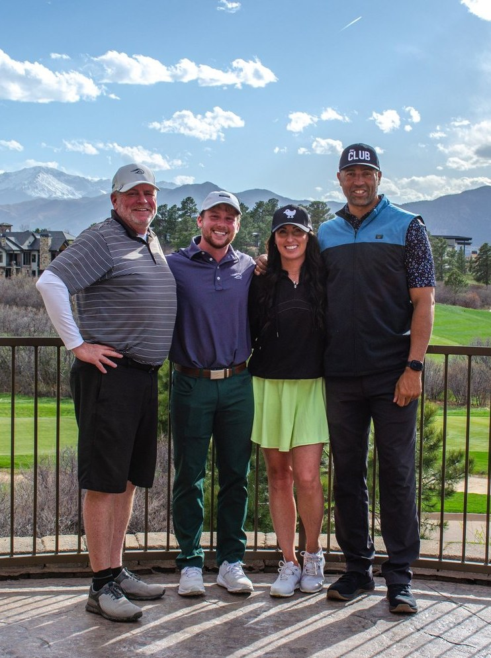
WHY FLYING HORSE
Home turf for the heroes you play for
For 18 years, Innospec's tournaments have raised more than $2.68 million for the PenFed Foundation Military Heroes Program. The setting should honor that.
Our Weiskopf Course looks out over the United States Air Force Academy, and Colorado Springs is home to five military installations. Your sponsors tee off in the heart of one of America's proudest military communities.
15 MIN
5
102
to the U.S. Air Force
Academy (approx.)
military installations
in Colorado Springs
rooms, all yours
in a full buyout
FLYING HORSE RESORT & CLUB | INNOSPEC CHARITY GOLF TOURNAMENT 2027
3
Notes:
Five installations: Fort Carson, Peterson SFB, Schriever SFB, Cheyenne Mountain SFS, USAFA. Drive time to USAFA is approximate. $2.68M / 18 years from innospecsustainability.com.

Slide 4
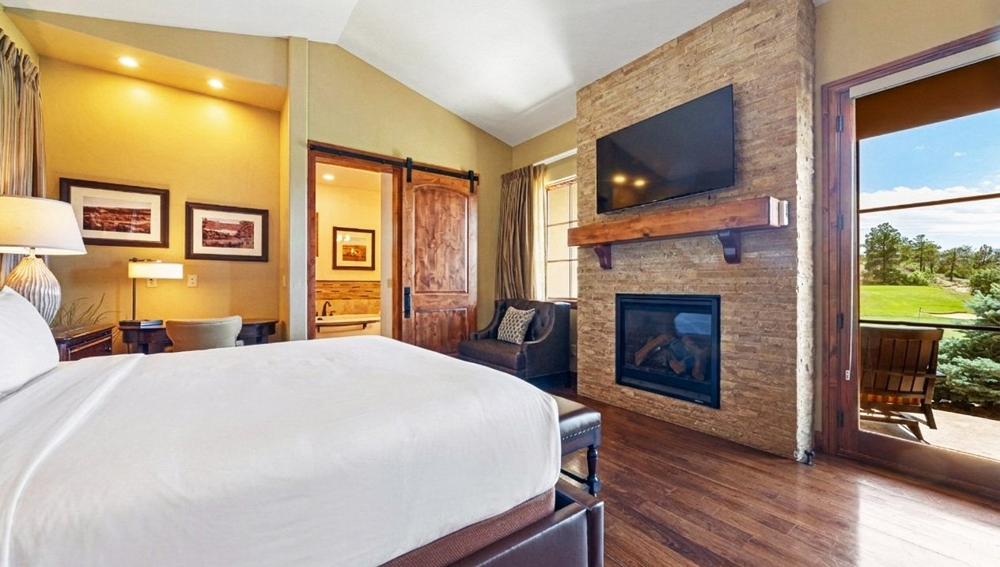
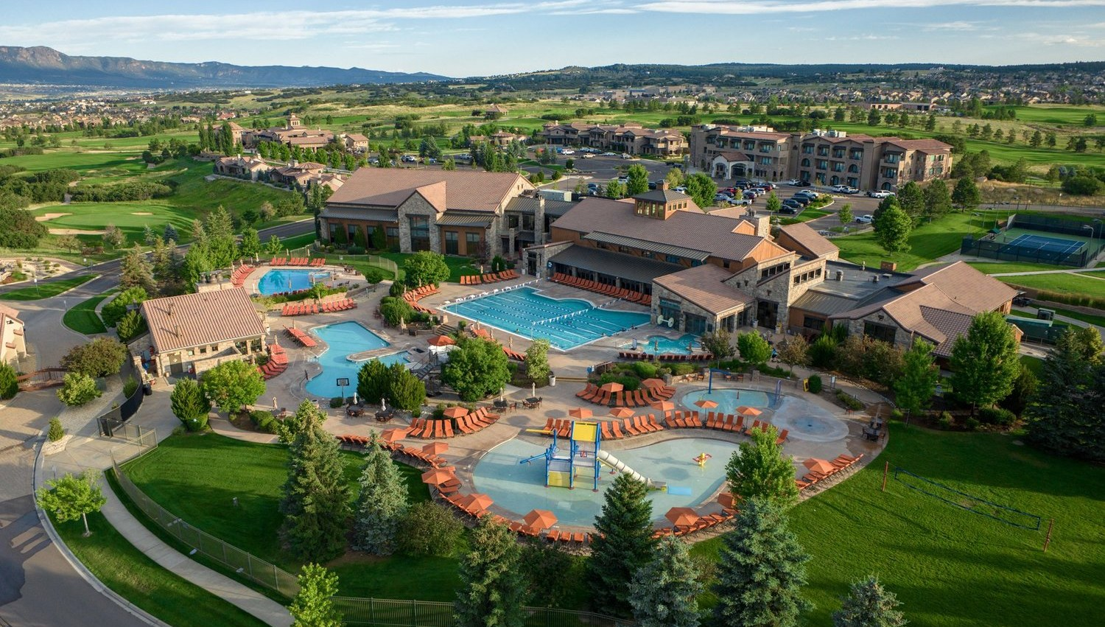
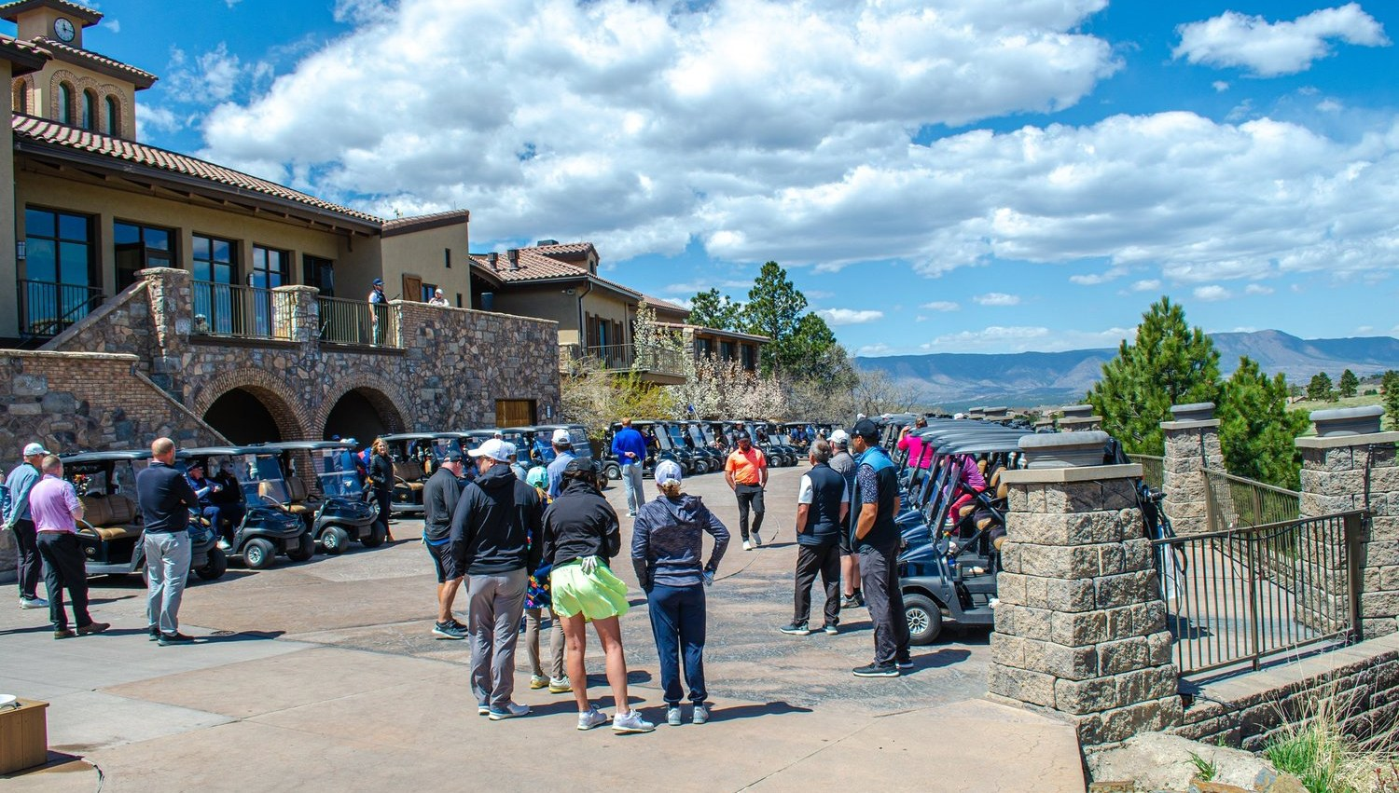
THE WEEKEND AT A GLANCE
Arrive Sunday. Play Monday. Leave inspired.
SATURDAY, AUG 14
SUNDAY, AUG 15
MONDAY, AUG 16
Early Arrivals
The Resort Is Yours
Tournament Day
• Optional guestroom pickup for early arrivals
• Dinner at The Steakhouse
• Sunset on a private balcony
• Full Lodge buyout for sponsors and spouses
• Afternoon at The Spa, pool and Athletic Club
• Welcome reception with Pikes Peak views
• Breakfast and warm-up on the practice range
• Charity tournament on the Weiskopf Course
• Lunch and awards, then safe travels home
FLYING HORSE RESORT & CLUB | INNOSPEC CHARITY GOLF TOURNAMENT 2027
4
Notes:
Saturday pickup per Sarah's email. Itinerary is a suggested flow; final timing set with Innospec.

Slide 5

01 | THE GOLF
Championship golf, framed by Pikes Peak
Where the legend of Flying Horse was born

Slide 6
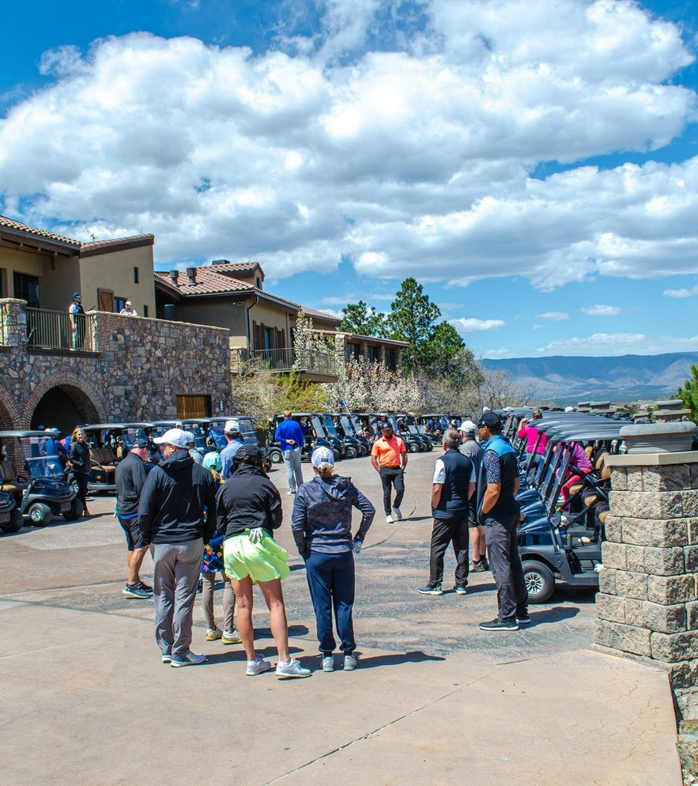
YOUR TOURNAMENT COURSE
The Weiskopf Course
Designed by legendary architect Tom Weiskopf, our Club Course has hosted golfers from around the world since 2005.
• Voted Best Golf Course in Colorado Springs by The Gazette, 2024, 2025 and 2026
• Picture-perfect views of Pikes Peak and the U.S. Air Force Academy
• A links feel with a signature 16-17-18 finish that makes or breaks a round
• Certified Audubon Cooperative Sanctuary, so expect Colorado wildlife
FLYING HORSE RESORT & CLUB | INNOSPEC CHARITY GOLF TOURNAMENT 2027
6

Slide 7
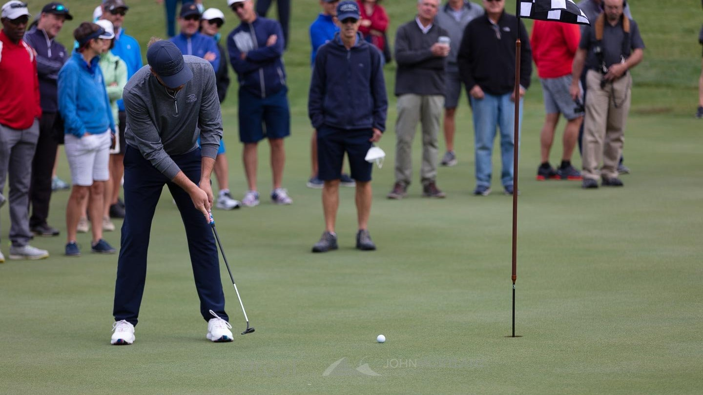
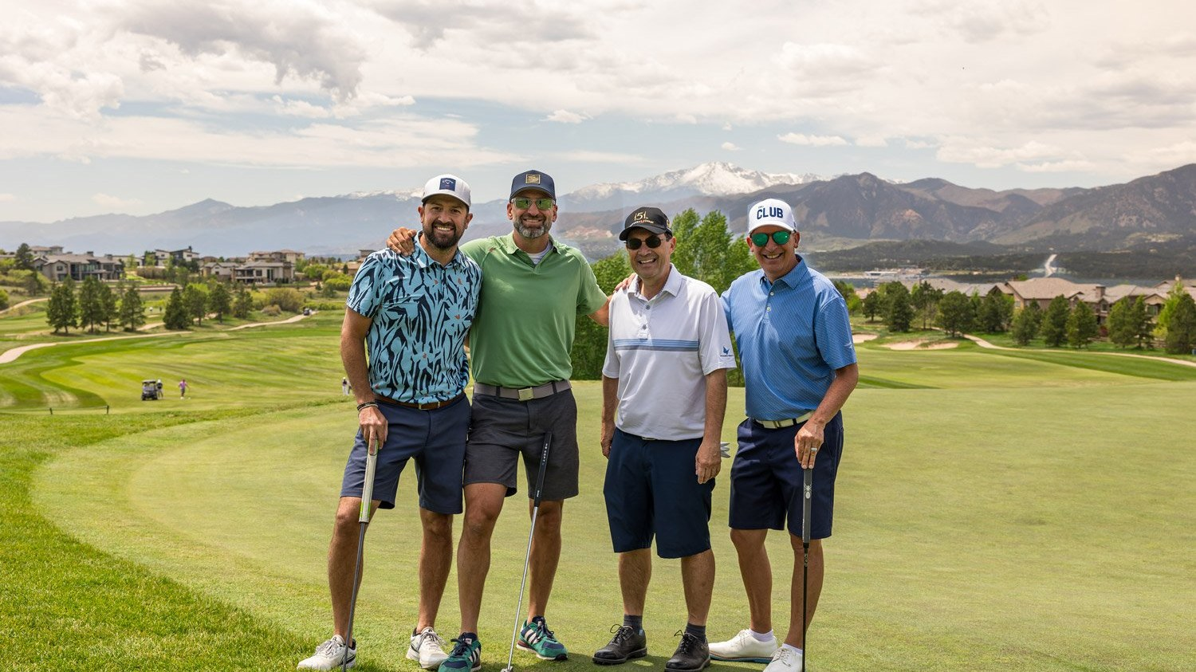
TOURNAMENT DAY + GOLF PRICING
Run by our PGA team, start to finish
Head Golf Professional Mack Borowicz, PGA, and our team handle the details. Your sponsors simply play.
• Shotgun start; range opens 90 minutes before
• Fields of 72 to 120 golfers, more with added carts
• Scoring and hole contests set up by our team
$130
per golfer, including green fees,
cart and practice range
AVAILABLE MONDAYS
August 2 • August 9 • August 16 • August 23
FLYING HORSE RESORT & CLUB | INNOSPEC CHARITY GOLF TOURNAMENT 2027
7
Notes:
$130 per golfer per Mack's email, for any of the August Mondays listed. Per the 2026 Golf Events Packet: rate includes green fees, cart fees, practice range, inclusive of RSF. Min 72 players, max 120 with cart fleet (more needs 45 days' notice for rental carts, cost split 50/50). Lunch for all players required; $750 Golf Shop retail minimum; scoring/hole contest setup $100 per day. Innospec's page says 'hundreds of golfers' across events: confirm their field size.

Slide 8
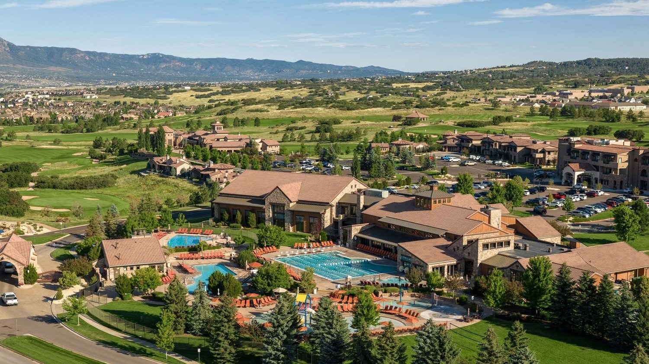
02 | THE RESORT
A AAA Four Diamond resort, all to yourselves
Tuscan warmth meets the Rocky Mountains

Slide 9
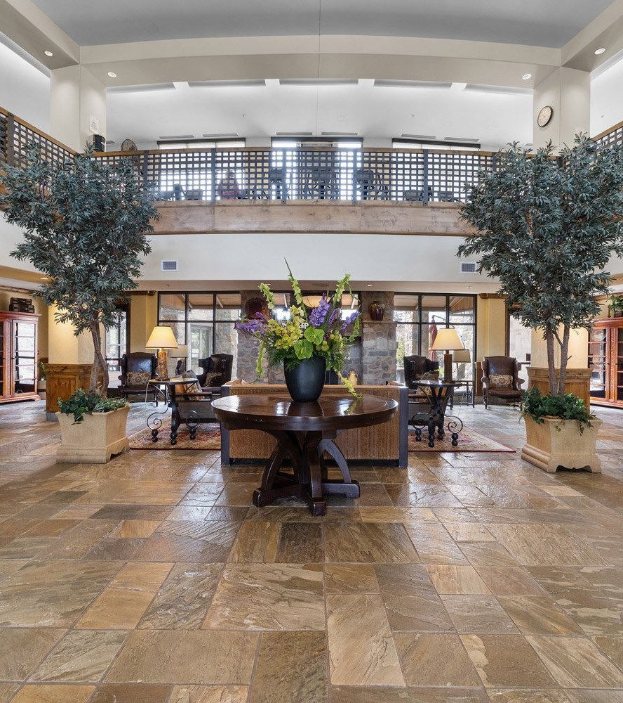
THE LODGE AT FLYING HORSE
Your own private resort
Small enough to know your story. Big enough to deliver your vision. With a full buyout, all 102 rooms, suites and villas belong to your sponsors and their guests.
• AAA Four Diamond designation
• Every guestroom is 500+ square feet with a private balcony or patio
• Views of the golf course or the Front Range
• Oversized showers, Nespresso and work desks in every room
FLYING HORSE RESORT & CLUB | INNOSPEC CHARITY GOLF TOURNAMENT 2027
9

Slide 10
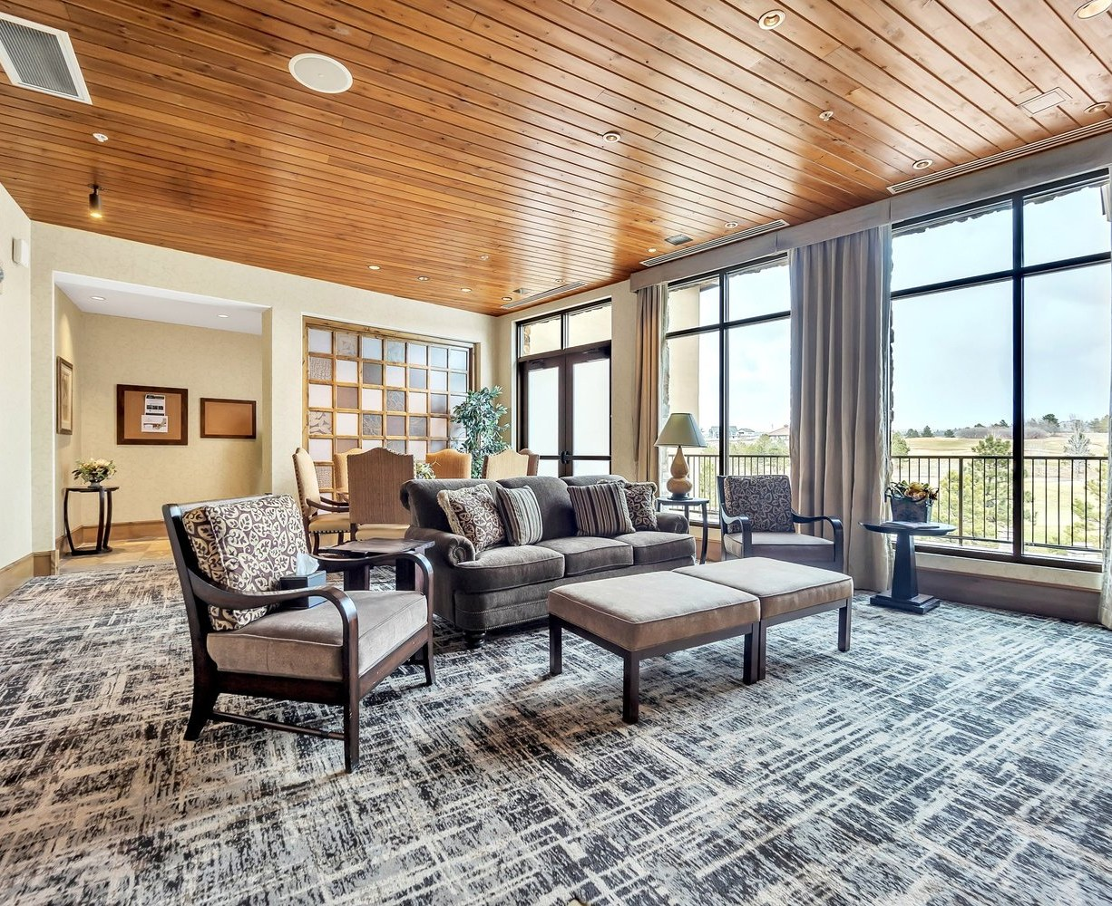
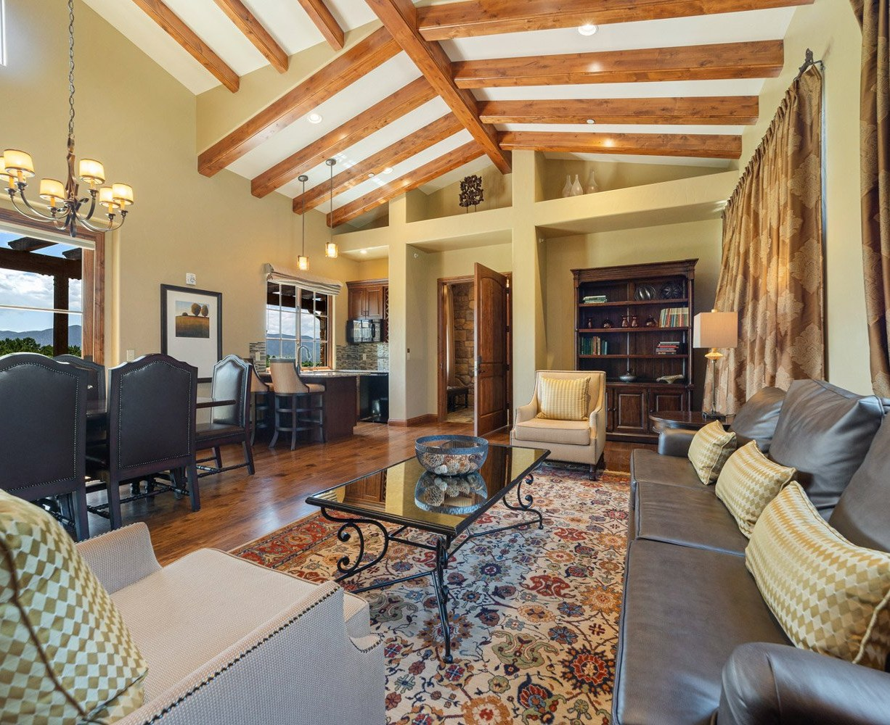
ACCOMMODATIONS + GROUP RATES
Rooms, suites and villas
Room type
Size
Sleeps
Rate / night
King or Double Queen
500+ sq ft
2 or 4
$340
Academy Suite
700 sq ft
2
$390
Deluxe Suite
725 sq ft
2
$440
Executive Suite
930 sq ft
2
$490
Presidential Suite
1,114 sq ft
2
$640
Tuscan Villa, one bedroom
1,650 sq ft villa
2
$640
Tuscan Villa, two bedroom
1,650 sq ft villa
4
$1,080
A significantly reduced group rate for your buyout, per room, per night.
Rates do not include the $35 nightly resort amenity fee, 2.95% retail sales fee, or state and city occupancy taxes (currently 10.2% combined). Final room block and counts will be confirmed in your formal agreement.
FLYING HORSE RESORT & CLUB | INNOSPEC CHARITY GOLF TOURNAMENT 2027
10
Notes:
Rates from Sarah Leach's email. Villa sizes: each villa 1,650 sq ft with two king bedrooms; booked as one- or two-bedroom. Open question from Sarah: master billing or individual?

Slide 11
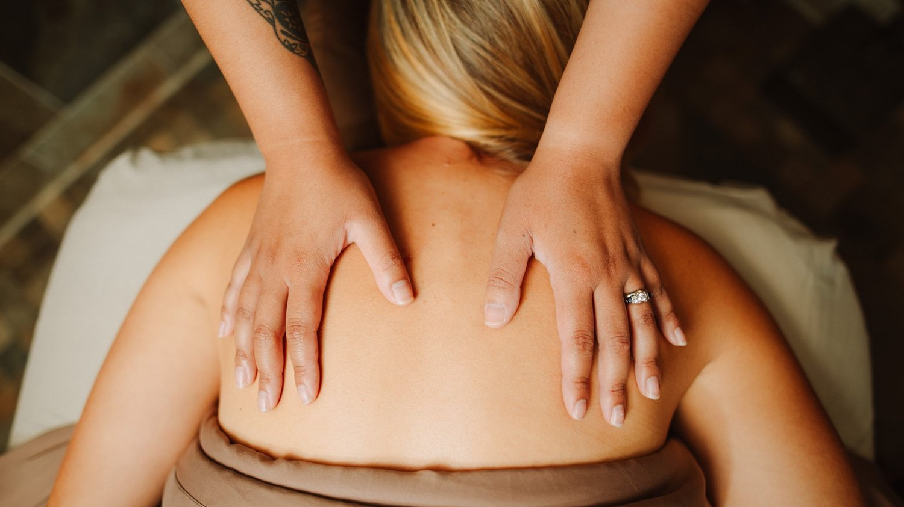
03 | THE EXPERIENCE
Something for every guest, golfer or not
Spa, club and resort life for sponsors and spouses

Slide 12
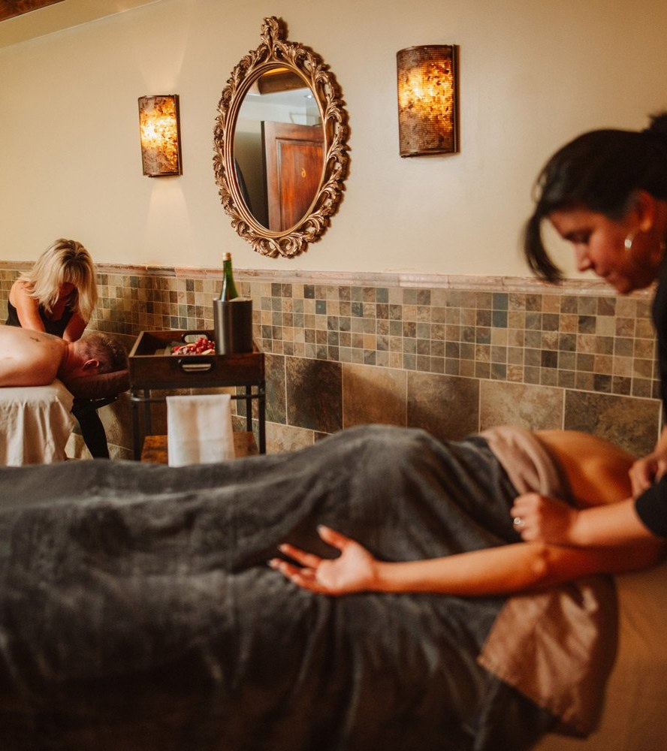
WHILE THE GOLFERS PLAY
The Spa at Flying Horse
Spouses and guests trade the fairway for a serene haven of renewal. Every service includes access to the whirlpool and steam room.
SPA MENU | GUEST RATES
Flying Horse Signature Experience
80 / 100 min
$230 / $285
Serenity Massage
50 / 80 min
$155 / $210
Signature Facial
50 / 80 min
$155 / $210
Couples Celebration Package
110 min, per couple
$560
A Taste of The Spa
mini spa day
$270
Head to Toe
massage, facial, mani, pedi
$450
Ultimate Spa Day
the full indulgence
$615
Per person unless noted. Gratuity not included; 2.95% retail sales fee applies. Private spa mornings can be arranged for your group.
FLYING HORSE RESORT & CLUB | INNOSPEC CHARITY GOLF TOURNAMENT 2027
12
Notes:
Guest rates from the Spa Booklet dated 1 June 2026 (flyinghorseresort.com/s/Spa-Booklet-1JUN2026-WEB.pdf). Confirm 2027 rates and any group spa pricing with the Spa team (719-487-2614).

Slide 13
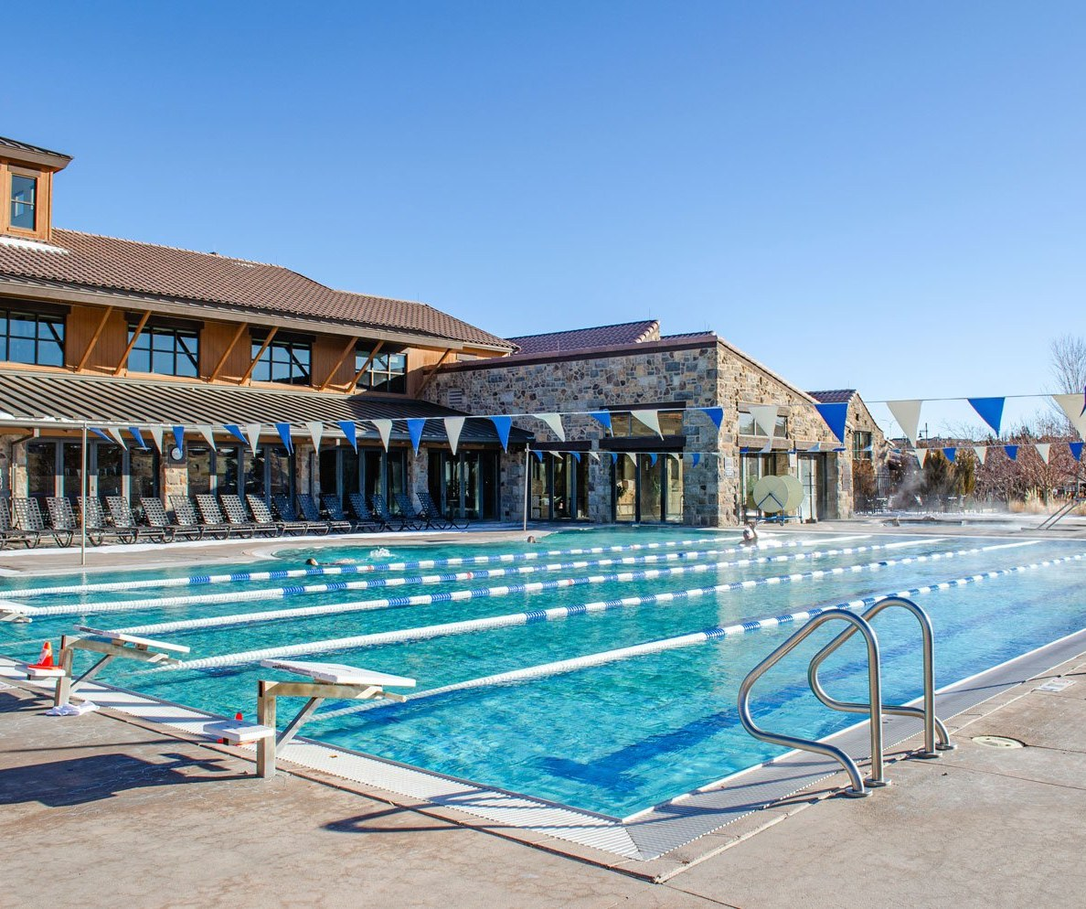
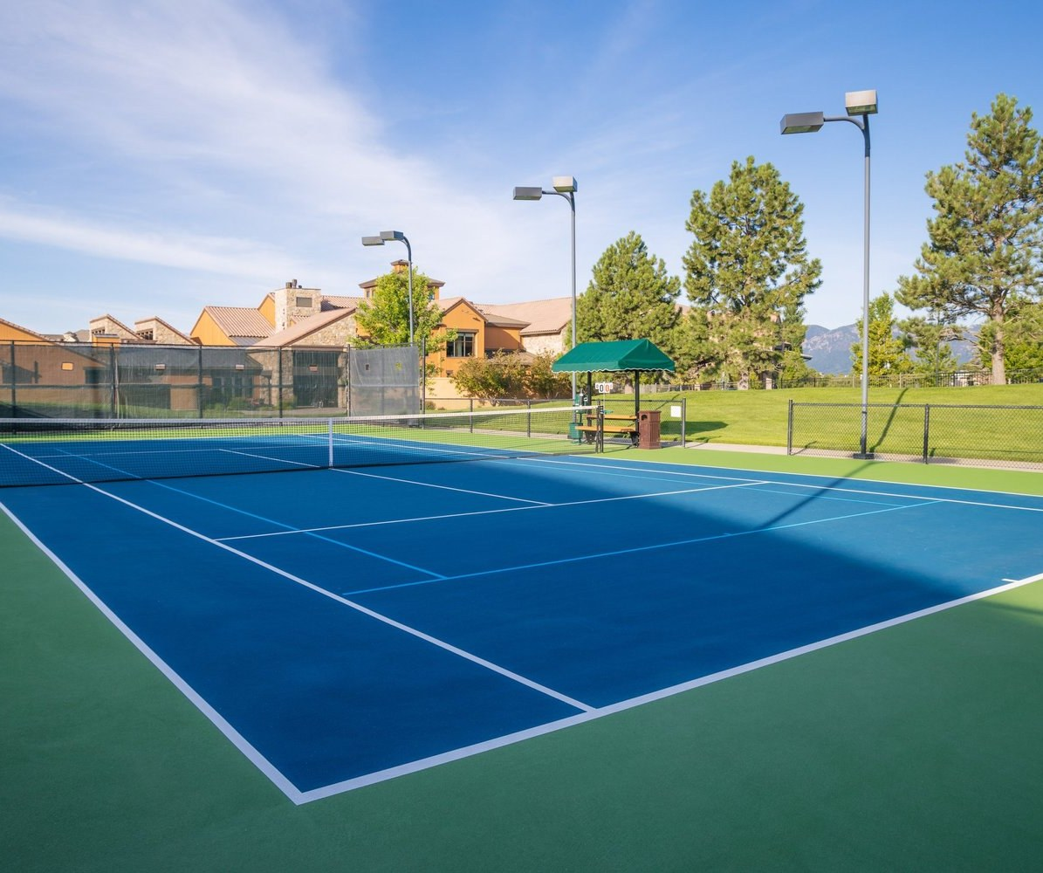
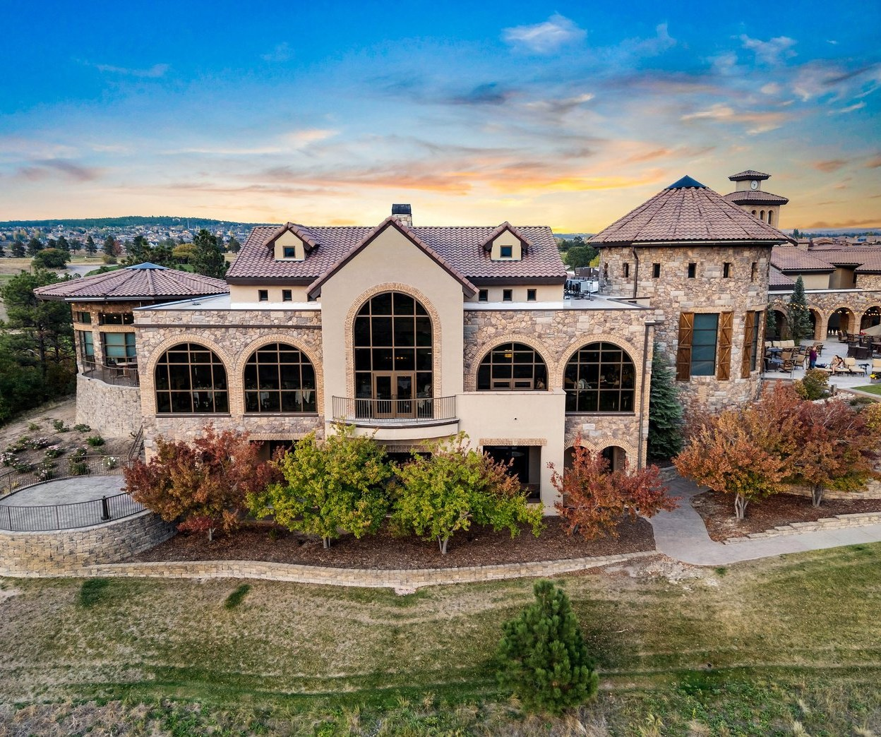
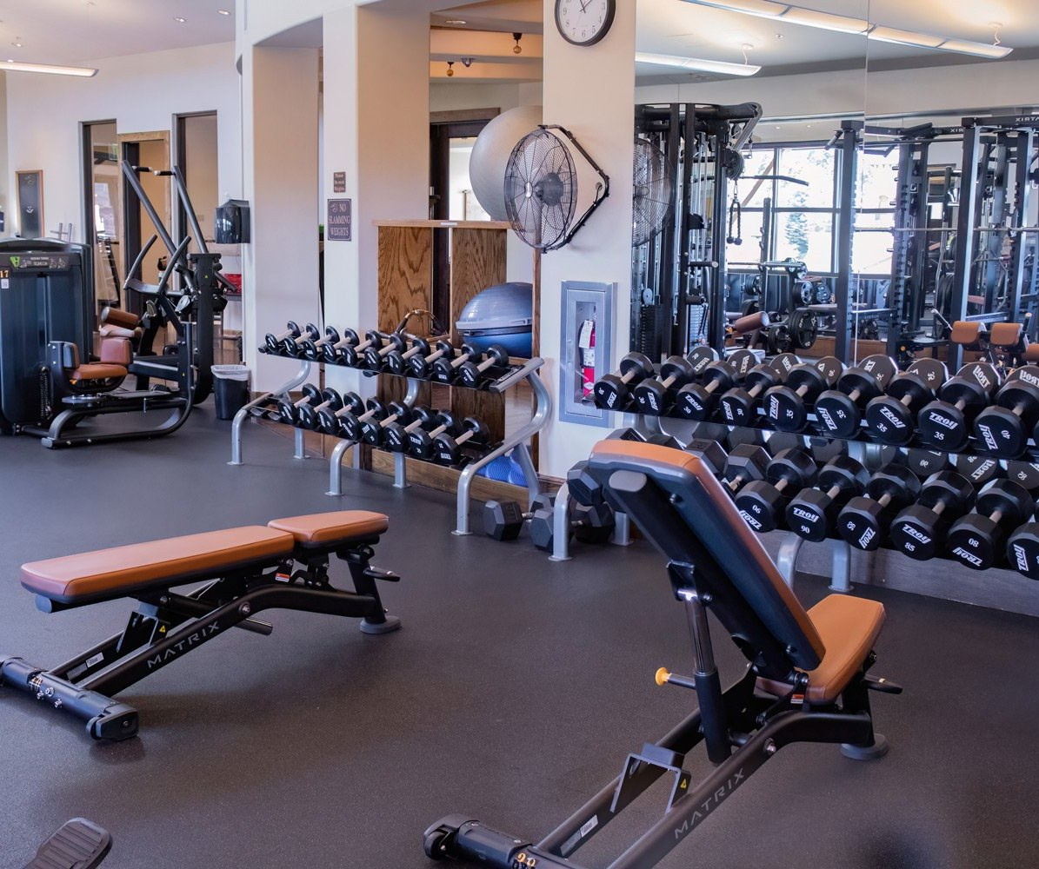
RESORT LIFE
The Athletic Club and beyond
Pools + Hot Tubs
Tennis + Pickleball
The Clubhouse
Fitness + Wellness
Heated 25-yard lap pool, indoor and outdoor hot tubs, plus the seasonal adult pool in August.
8 tennis courts, including 4 indoor red clay courts, and 4 pickleball courts with pro-led clinics.
A European-style clubhouse with fireside lounges, The Steakhouse and sweeping mountain views.
Mountain-view fitness center with group fitness and Pilates classes for guests.
FLYING HORSE RESORT & CLUB | INNOSPEC CHARITY GOLF TOURNAMENT 2027
13
Notes:
Amenity access for buyout guests and any fees to confirm with Sarah.

Slide 14

04 | THE FOOD
World-class dining, steps from your room
From a welcome toast to the awards lunch

Slide 15
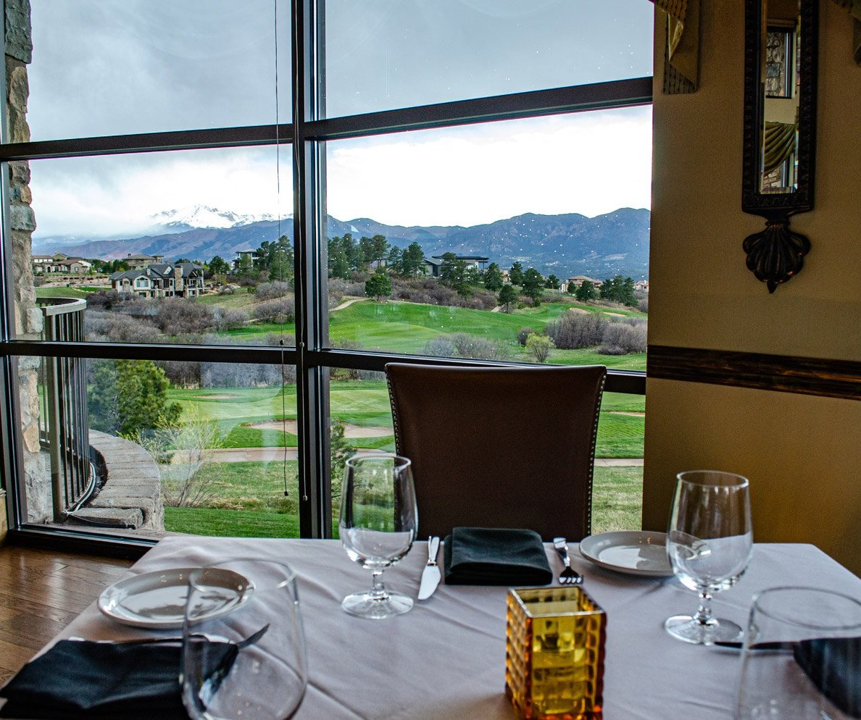

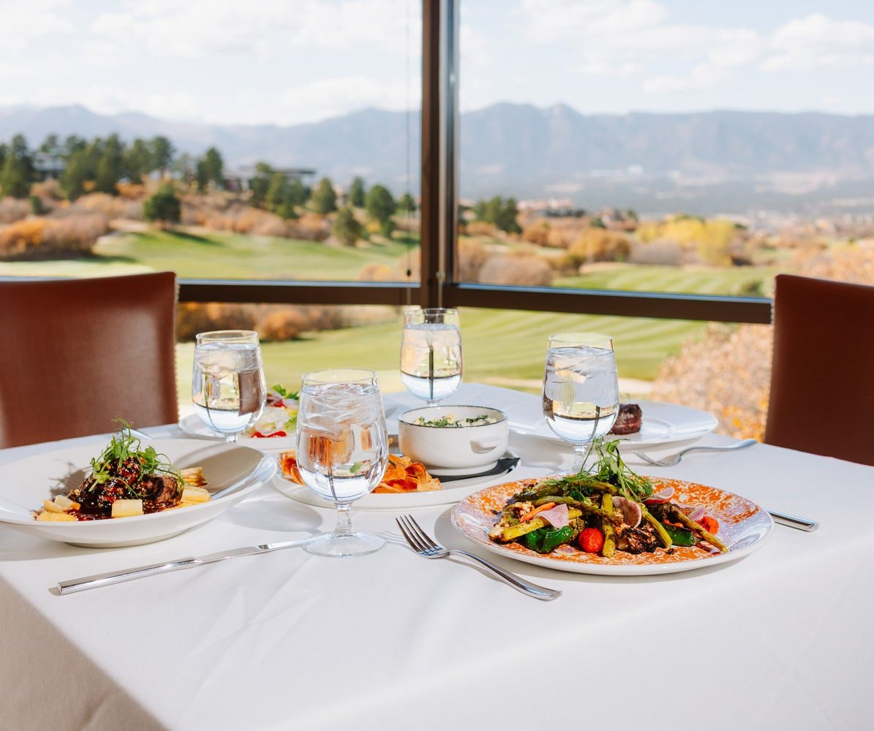
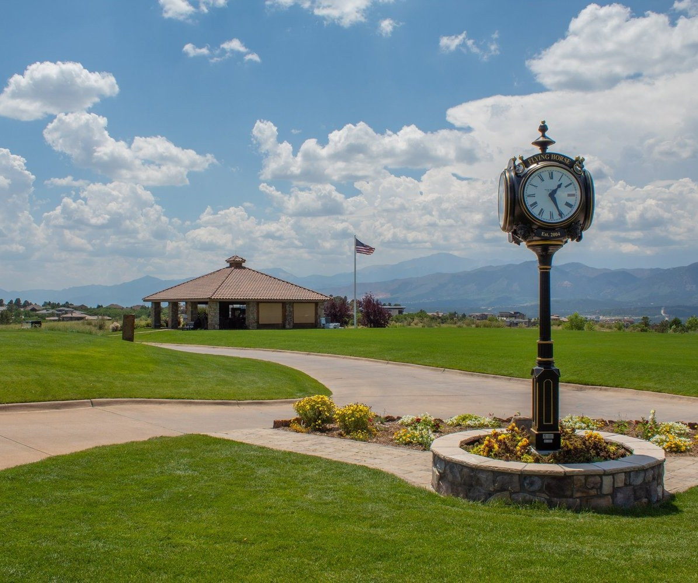
DINING AT FLYING HORSE
Four ways to feed a winning weekend
The Steakhouse
Fortezza Italiana
The Tack Room
The Pavilion
Award-winning prime steaks in a Tuscan-style villa. Wine Spectator Best of Award of Excellence since 2023, with a three-story wine tower.
Our newest restaurant, in the hotel lobby. Italian-inspired breakfast, lunch, dinner and daily happy hour.
Rustic elegance overlooking Hole 15. Perfect for a post-round lunch and a toast to the winners.
On the Weiskopf Course near the range, for grab-and-go fuel on tournament day.
FLYING HORSE RESORT & CLUB | INNOSPEC CHARITY GOLF TOURNAMENT 2027
15

Slide 16
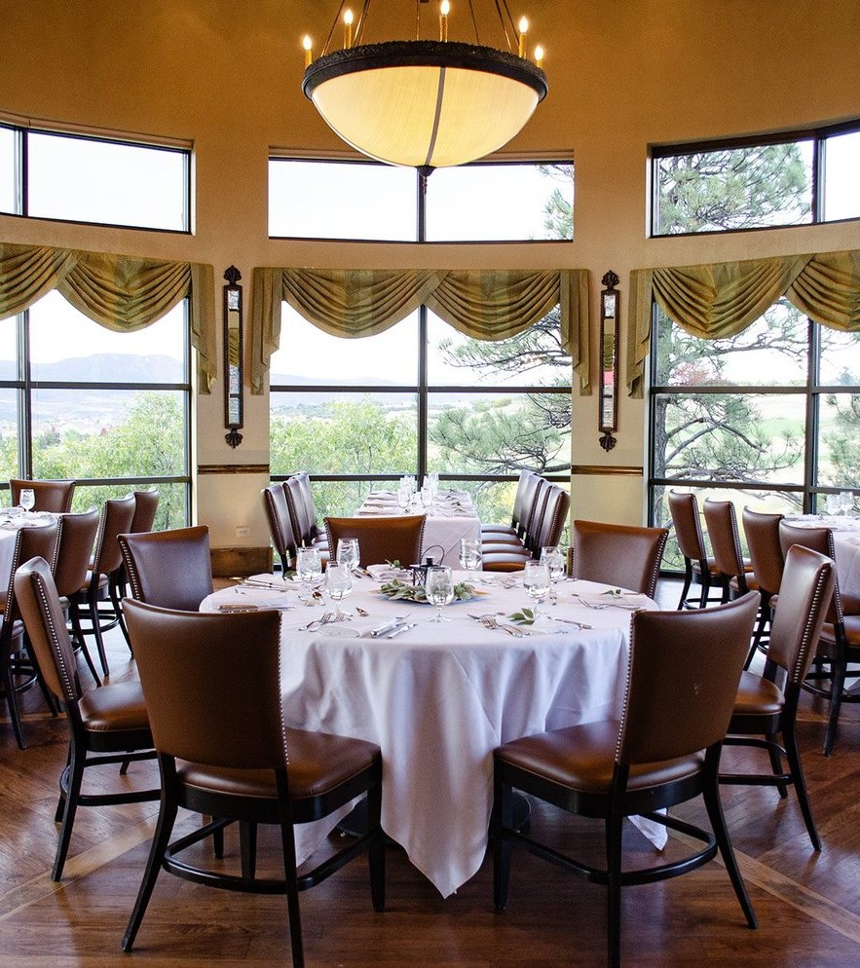
MORE PRIVATE SPACES
Intimate rooms for top sponsors
When you want a smaller moment for your title sponsors or board, we have rooms made for it.
• The Rotunda: a private room inside The Steakhouse with 300-degree views of the Front Range. Banquet 40, reception 50
• Thomas Blake Ballroom: Pikes Peak views and two patios with a fire pit. Banquet 140, reception 200
• Sienna: an intimate room in the Clubhouse wine tunnel. Dinner for 12 to 18
FLYING HORSE RESORT & CLUB | INNOSPEC CHARITY GOLF TOURNAMENT 2027
16

Slide 17
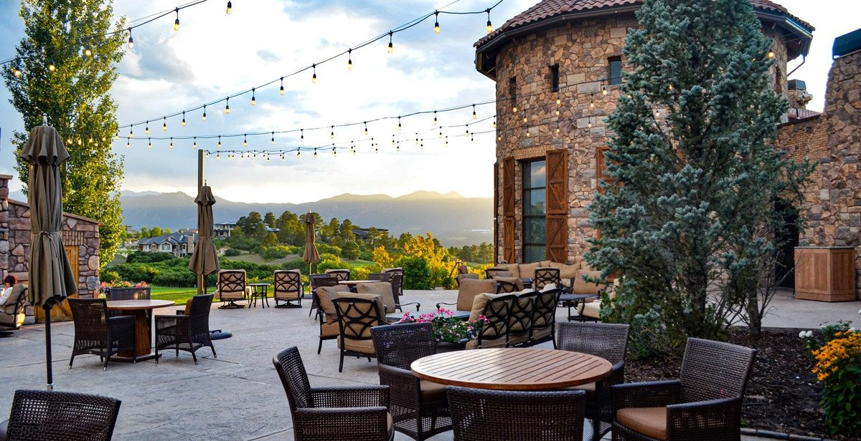
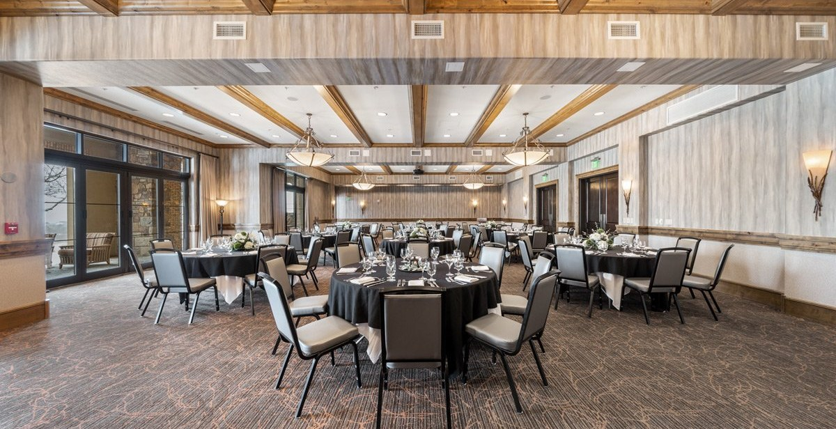
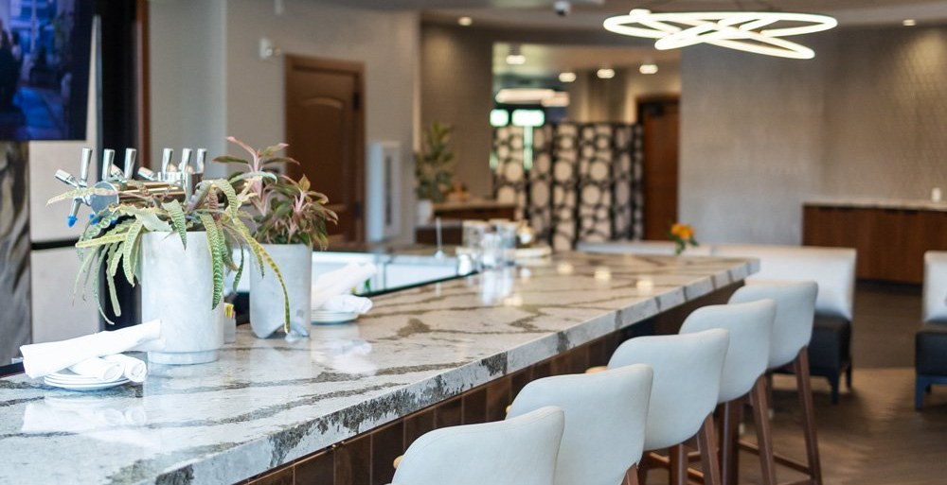
EVENT SPACES + FOOD AND BEVERAGE MINIMUMS
Three stages for your weekend
F&B MINIMUM
$10,000
Sunday welcome reception
F&B MINIMUM
$15,000
Tournament lunch + awards
F&B MINIMUM
$3,000
Sponsor breakfast or dinner
Clubhouse Courtyard
Barolo Ballroom
Fortezza Dining Room
• Outdoor fireplaces, fountains, mountain and golf course views
• Beside the three-story wine tower and The Steakhouse
• Capacity: [to confirm]
• Weather backup: [to confirm]
• 3,700 sq ft, 56' x 67', 15' ceilings
• Banquet 240 | Reception 300 | Theater 240
• Floor-to-ceiling windows, full A/V
• Adjoining Fortezza pre-function space
• Our newest restaurant, in the hotel lobby
• Italian-inspired menus and a curated wine list
• Capacity: [to confirm]
• Steps from every guestroom
Minimums are food and beverage spend before service charge and tax. Menus by our culinary team, with steaks cut in our on-site butcher shop.
FLYING HORSE RESORT & CLUB | INNOSPEC CHARITY GOLF TOURNAMENT 2027
17
Notes:
Minimums from Shanna Hughes: Clubhouse Courtyard $10k, Barolo Ballroom $15k, Fortezza dining room $3k. Barolo specs from FH capacity chart (Oct 2025). Courtyard and Fortezza capacities are NOT on the chart: get from Shanna. Confirm the minimums exclude service charge and tax, and whether any room rental applies. Suggested use of each space is ours.

Slide 18
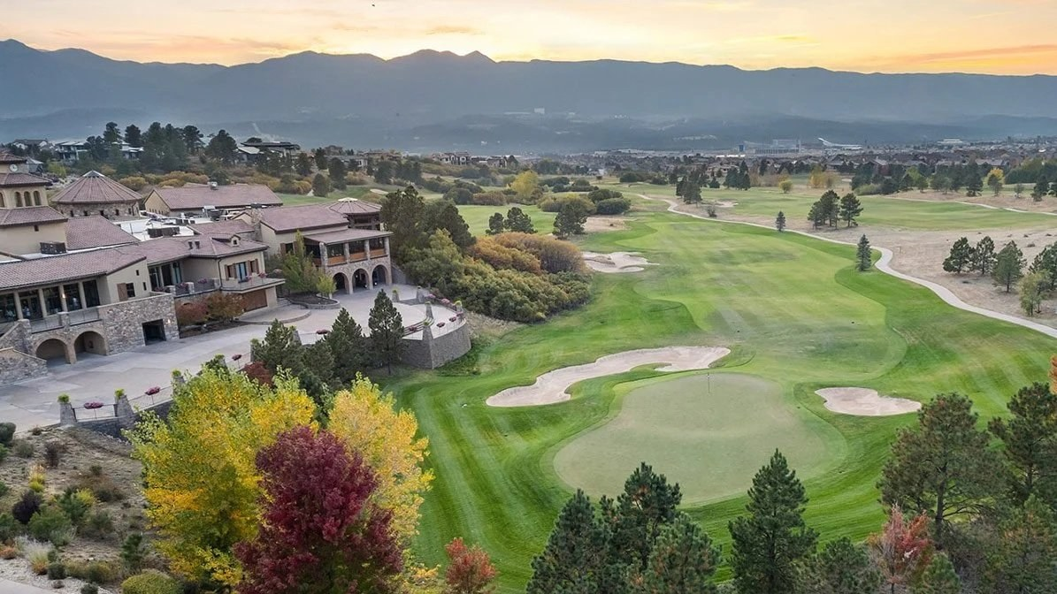
05 | BEYOND THE RESORT
Colorado Springs, at your doorstep
Attractions for guests and nearby hotels for your team

Slide 19
NEARBY ATTRACTIONS
Make a weekend of it
ABOUT 15 MIN
ABOUT 25 MIN
ABOUT 25 MIN
U.S. Air Force Academy
Garden of the Gods
U.S. Olympic & Paralympic Museum
Cadet Chapel, the visitor center and the Honor Court. A fitting stop for this group.
Towering red rock formations and easy walking trails. Free to visit.
Downtown Colorado Springs, in America's Olympic City.
ABOUT 35 MIN
ABOUT 30 MIN
ABOUT 35 MIN
Pikes Peak
Manitou Springs
Cheyenne Mountain Zoo
America's Mountain, by the Cog Railway or the scenic highway.
Historic mountain town with shops, galleries and natural mineral springs.
America's only mountain zoo, famous for its giraffe herd.
FLYING HORSE RESORT & CLUB | INNOSPEC CHARITY GOLF TOURNAMENT 2027
19
Notes:
Drive times are approximate from Flying Horse Resort; verify before sending.

Slide 20
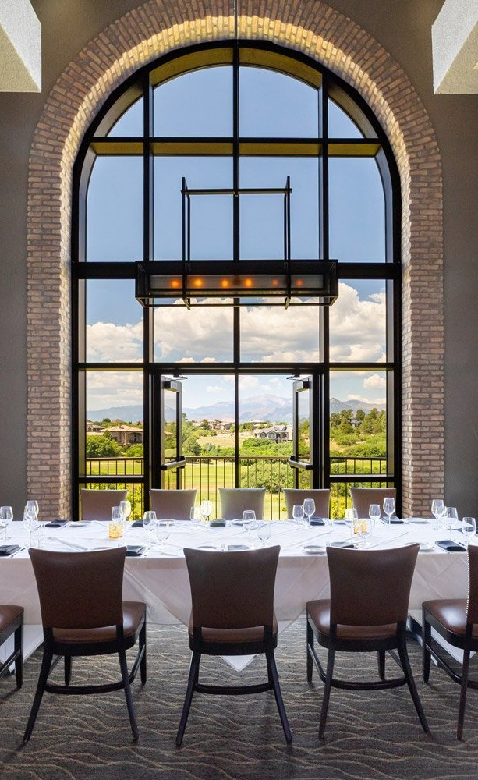
OVERFLOW LODGING
Nearby hotels for staff
Sponsors stay with us. For staff and any overflow, these hotels sit about 10 minutes away near InterQuest Parkway and the Air Force Academy. We're happy to introduce you to our local hotel partners.
Hotel Polaris
At the U.S. Air Force Academy Visitor Center
Courtyard Colorado Springs North / Air Force Academy
1130 InterQuest Parkway
Drury Plaza Hotel Near the Air Force Academy
1170 InterQuest Parkway
Residence Inn Colorado Springs North / Air Force Academy
InterQuest area
SpringHill Suites Colorado Springs North / Air Force Academy
1320 Republic Drive
Hampton Inn & Suites Colorado Springs Air Force Academy / I-25 North
1307 Republic Drive
FLYING HORSE RESORT & CLUB | INNOSPEC CHARITY GOLF TOURNAMENT 2027
20
Notes:
Addresses from hotel listings (Marriott, Hilton, Visit COS). Sarah mentioned local hotel partners; swap in her preferred partners if different.

Slide 21
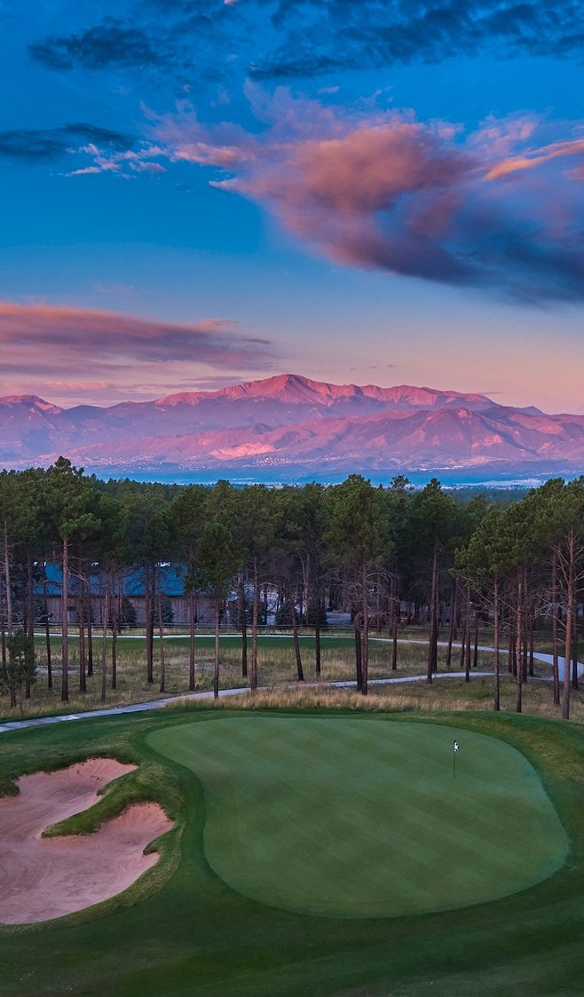
YOUR INVESTMENT, IN PERSPECTIVE
Spend it where it counts
PLAY
$130
Championship golf, cart and practice range on the Best Golf Course in Colorado Springs
THE BEST RETURN
95¢
of every dollar raised goes directly to service members and their families.
per golfer
STAY
$340
A AAA Four Diamond resort, all to yourselves, at a significantly reduced group rate
per room, per night
GATHER
$3,000
Three stages for your weekend, from Fortezza to the Barolo Ballroom
F&B minimums from
PRICELESS, AND ON THE HOUSE
Pikes Peak at sunrise, 300 days of Colorado sunshine, and the U.S. Air Force Academy just down the road.
Room rates exclude the $35 nightly resort amenity fee, 2.95% retail sales fee and occupancy taxes. F&B minimums exclude service charge and tax.
FLYING HORSE RESORT & CLUB | INNOSPEC CHARITY GOLF TOURNAMENT 2027
21
Notes:
Closing value slide: per-person investment at each stop, framed against Innospec's 95-cents-to-heroes promise. No totals, per Kate. '300 days of sunshine' is Flying Horse's own website claim.

Slide 22
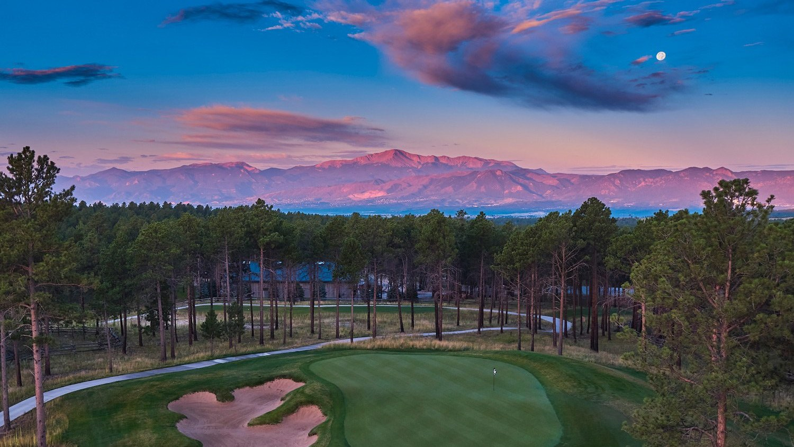
WHERE BELONGING & CONNECTION MEET
Let's make 2027 the most memorable tournament yet
1. Hold your preferred August date
2. Join us for a site visit or group call
3. Receive your full catering and room proposal
YOUR FLYING HORSE TEAM
Mack Borowicz, PGA, Head Golf Professional | mborowicz@flyinghorseclub.com
Sarah Leach, Sales Manager | SLeach@flyinghorseclub.com
JoDee McGinnis, Director of Catering | JMcGinnis@flyinghorseclub.com
Shanna Hughes, Catering Sales Manager | SHughes@flyinghorseclub.com
FLYING HORSE RESORT & CLUB | INNOSPEC CHARITY GOLF TOURNAMENT 2027
22
Notes:
Golf Shop 719-487-2620. 1880 Weiskopf Point, Colorado Springs, CO 80921.

